Slide 1
EDA CREDIT ASSESSMENT
SIDDHANT GADGE
DSC61

Slide 2
Purpose
Credit risk analysis will help the company to make a decision for loan approval based on the applicant's profile.
Which controls loss of business to the company and avoid financial loss for the company.

Slide 3
Following was the approach of the analysis>>

Slide 4
Steps taken
Data understanding and sourcing
Check for Data quality issues and Binning
Check for Data imbalance and univariate,segmented univariate & Bivariate analysis,correlation
Merging of application data with previous application data
Data analysis by univariate, segmented univariate, Bivariate analysis and correlation
Conclusion

Slide 5
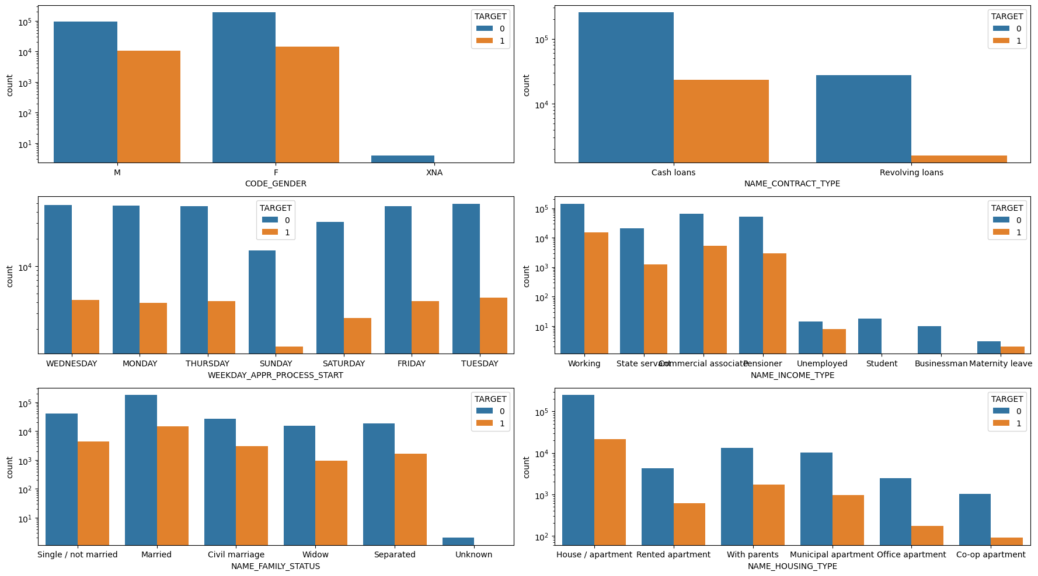
Categorical Univariate analysis for target
Observations:
Females tend to take more.
Cash loans are taken more.
Sundays,people usually not tend to come as other days.
Working people tend to take more
Married people tend to take more.
More number of people have house/apartment and tend to default

Slide 6
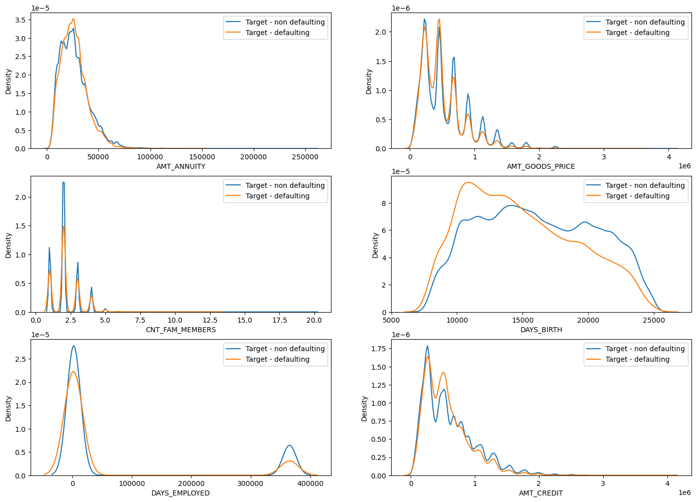
Univariate analysis
Observations:
With low annuity,people tend to take more loans.
With low goods price,tend to take more loans.
Lesser number of family members tend to take more loans.
10000 days old~27 years and 15000 days~41 years take more loans.
Higher loans from new joinees at job with less days and longer employees are taking lesser loans.
People with less credit take more loans.

Slide 7
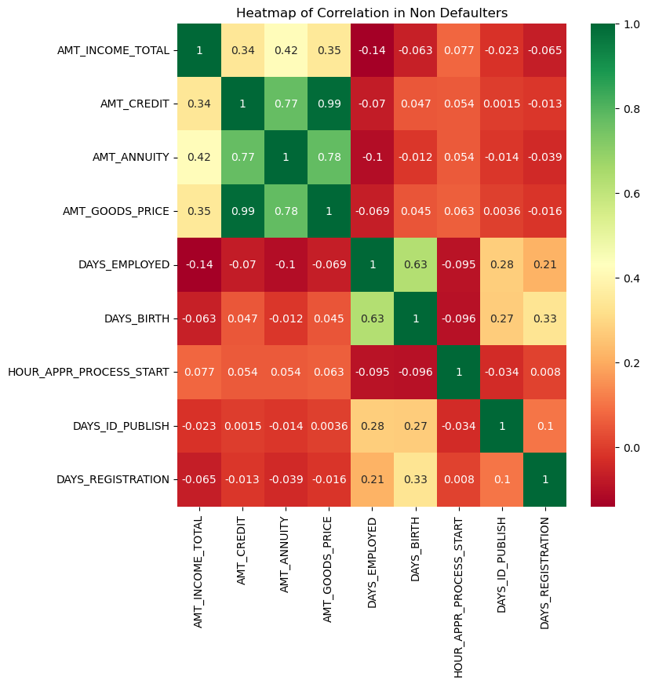
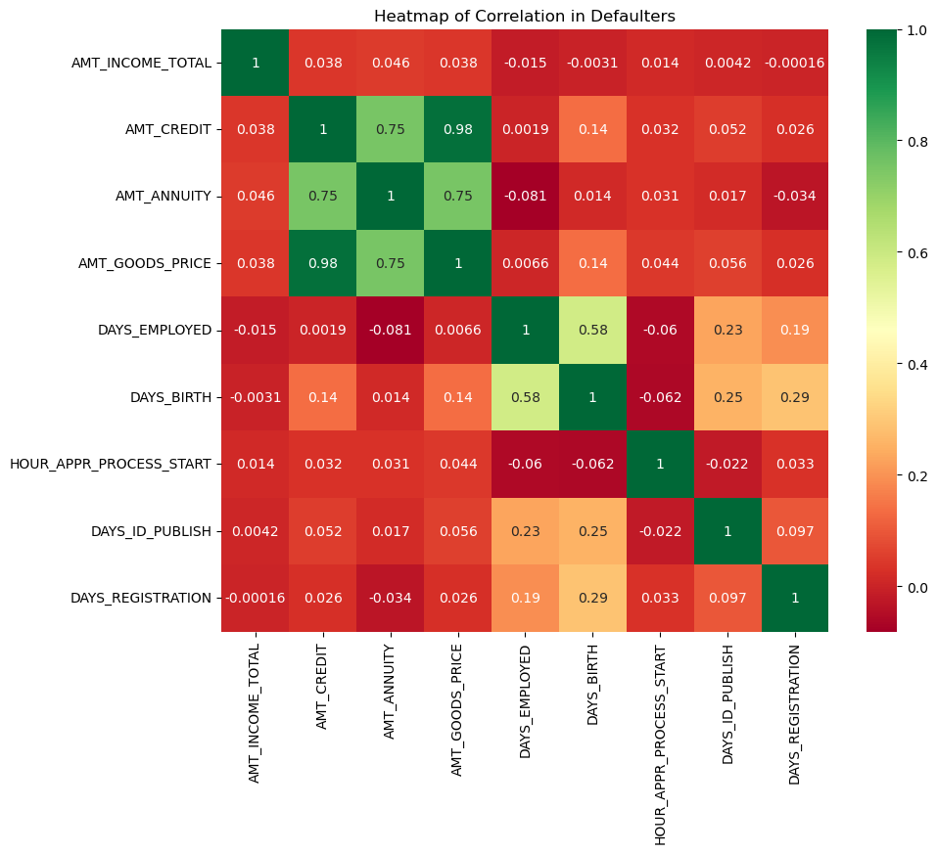
Correlation for non-defaulters and defaulters

Slide 8
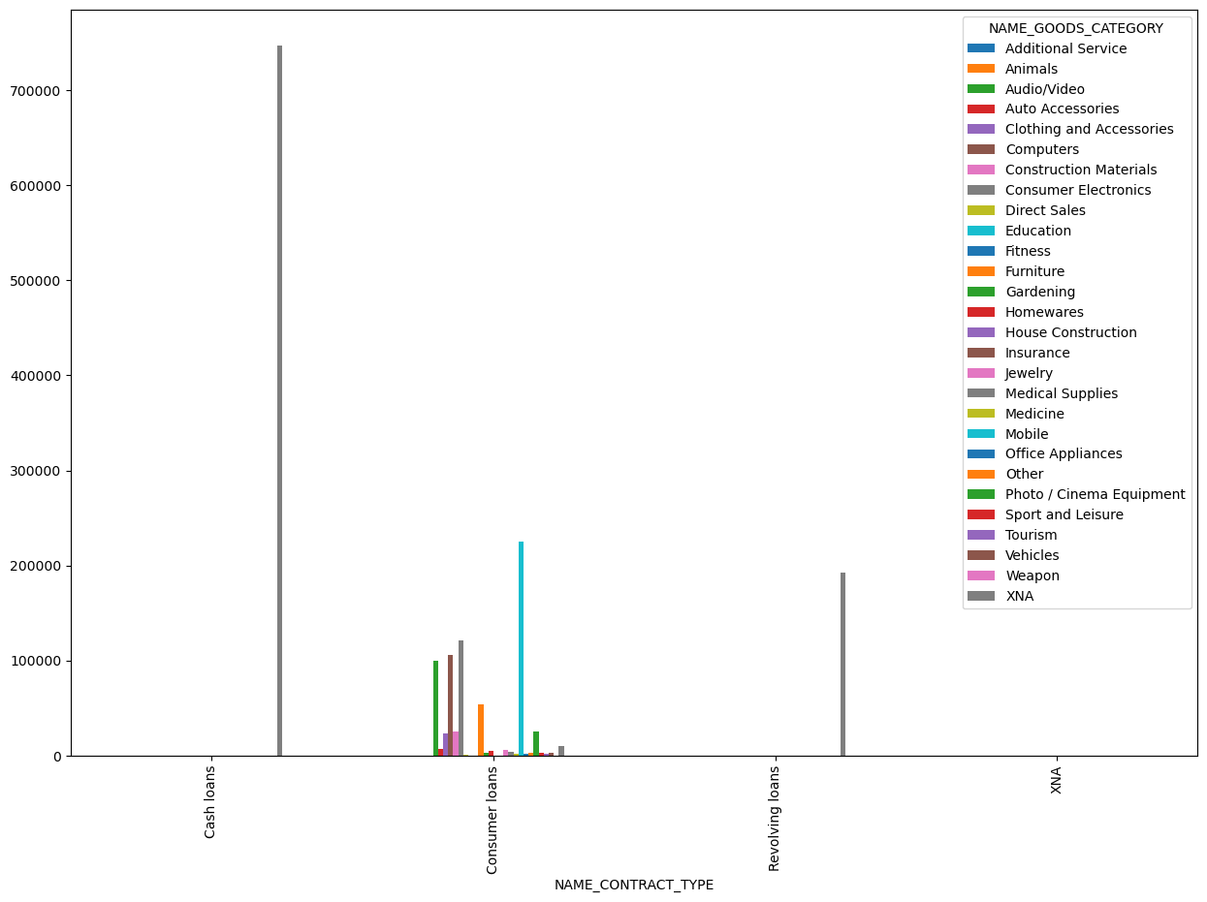
Bivariate analysis
Observations:
Consumer Electronics are taken the highest by cash loans

Slide 9
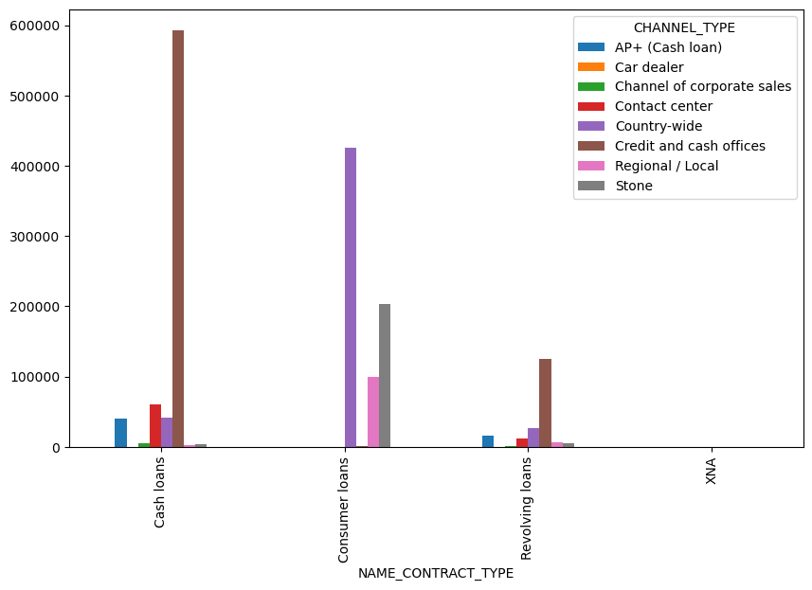
Bivariate analysis
Observations:
Credit and Cash Offices Procedures mostly on Cash Loans

Slide 10
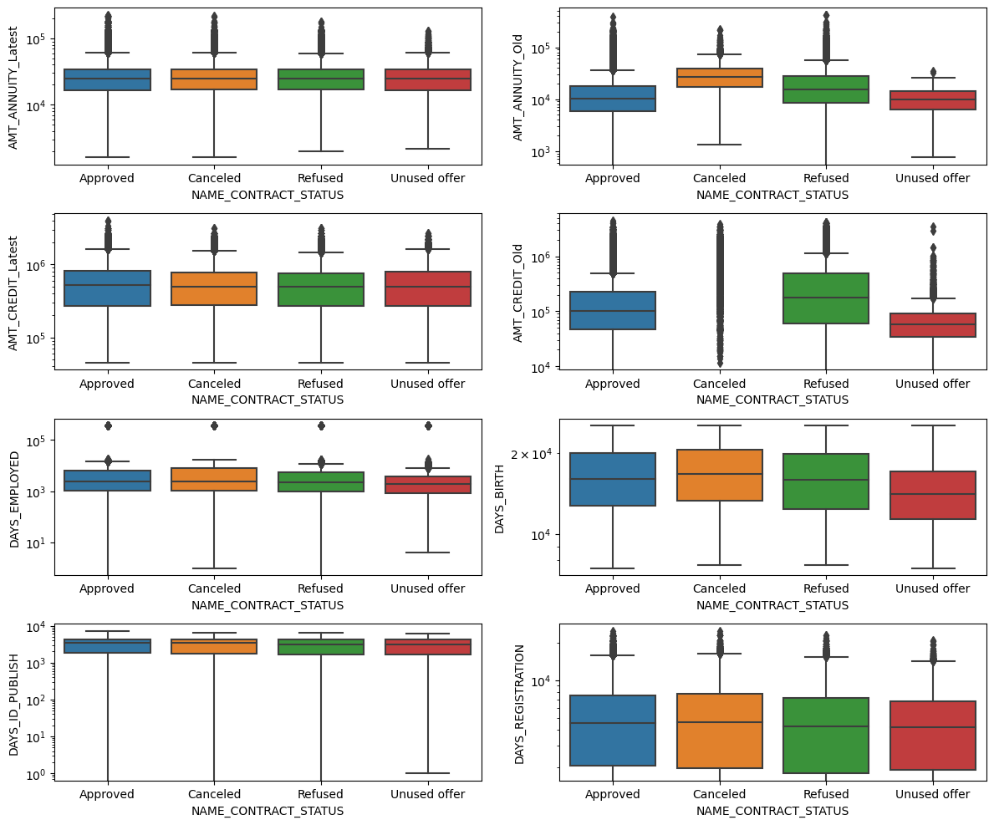
Bivariate categorical analysis
Observations:
#AMT_ANNUITY_Latest and AMT_CREDIT_Latest are the same
#AMT_CREDIT_Old Highest cancelled

Slide 11
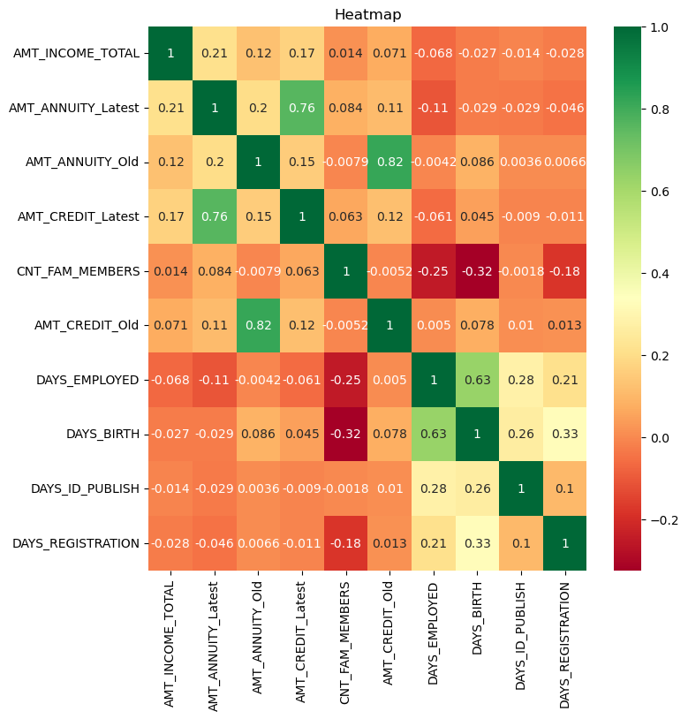
Correlation for non-defaulters and defaulters
Here, it has a good significant correlation
AMT_ANNUTIY_Latest with AMT_CREDIT_Latest = 0.76
AMT_ANNUITY_Old with AMT_CREDIT_Old = 0.82
DAYS_EMPLOYED with DAYS_BIRTH = 0.63

Slide 12
Conclusion
The clients who had gotten previous approval have less payment difficulties so they are better candidates for approval of loan.
Clients whose application was cancelled are more risk to default.
Banks should focus more on contract type 'Student','Pensioner and Businessman'
Occupation : Unemployed, unskilled labors and people with less stable jobs are more likely to default

